Slide 1

PROJECT ON
STOCK PRICE PREDICTION
USING MACHINE LEARNING
SHRI VAISHNAV VIDYAPEETH VISHWAVIDYALAYA
SHRI VAISHNAV INSTITUTE OF INFORMATION
TECHNOLOGY
By: Ankit Singh Tomar 17100BTCMCI01661 Ayush Gupta 17100BTCMCI01665
SUBMITTED TO:
GAURAV CHOUDHARY

Slide 2
PROBLEM DEFINITION:
Stock market prediction is basically defined as trying to determine the stock value and offer a robust idea for the people to know and predict the market and the stock prices. It is generally presented using the quarterly financial ratio using the dataset. Thus, relying on a single dataset may not be sufficient for the prediction and can give a result which is inaccurate. Hence, we are contemplating towards the study of machine learning with various datasets integration to predict the market and the stock trends. The problem with estimating the stock price will remain a problem if a better stock market prediction algorithm is not proposed. Predicting how the stock market will perform is quite difficult. The movement in the stock market is usually determined by the sentiments of thousands of investors. Stock market prediction, calls for an ability to predict the effect of recent events on the investors. These events can be political events like a statement by a political leader, a piece of news on scam etc. It can also be an international event like sharp movements in currencies and commodity etc. All these events affect the corporate earnings, which in turn affects the sentiment of investors. It is beyond the scope of almost all investors to correctly and consistently predict these hyperparameters. All these factors make stock price prediction very difficult. Once the right data is collected, it then can be used to train a machine and to generate a predictive result.

Slide 3
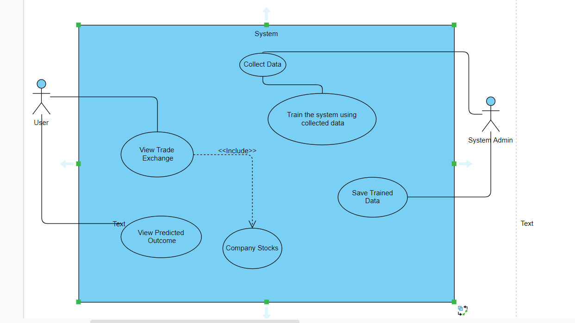
USE CASE DESCRIPTION:
DATA IS INITIALLY COLLECTED FROM ONLINE SOURCES OR STOCK MARKET.
THE DATA IS THEN USED TO TRAIN THE SYSTEM.
TRAINED MODEL IS SAVED.USER VIEWS THE TRADE EXCHANGE AND STOCK OF A COMPANY.
USING THE MODEL CLOSING PRICES ARE PREDICTED.

Slide 4
MACHINE LEARNING ALGORITHMS USED:
Support Vector Machine
SVM is considered to be one of the most suitable algorithms available for time series prediction. This supervised algorithm can be used in both, regression and classification. The SVM involves plotting of data as point in the space of n dimensions. These dimensions are attributes that are plotted on particular co-ordinates. SVM algorithm draws a boundary over the data set called the hyper-plane, which separates data into two classes.
Linear Regression
The most basic machine learning algorithm that can be implemented on this data is linear regression. The linear regression model returns an equation that determines the relationship between the independent variables and the dependent variable.
The equation for linear regression can be written as:
Here, x1, x2… .xn represent the independent variables while the coefficients θ1, θ2, …. θn represent the weights. You can refer to the following article to study linear regression in more detail:
A comprehensive beginner guide for Linear, Ridge and Lasso Regression.
Linear regression performs the task to predict a dependent variable value (y) based on a given independent variable (x). So, this regression technique finds out a linear relationship between x (input) and y(output). Hence, the name is Linear Regression.

Slide 5
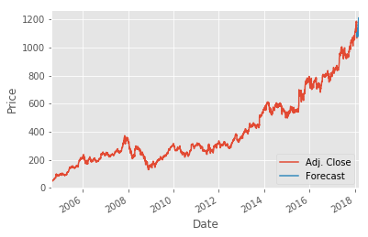
RESULTS: PREDICTED VALUES:

